Slide 1
Introduction to Information Systems and Programming
Recursion

Slide 2
Recursion
Use recursive method
Recursive method: one that calls itself
Simpler solution to some problems that are difficult to solve using loops

Slide 3
Recursive factorial
n! = 1 if n==0
n! = n x (n-1)! else
public static int factorial(int n) {
if (n==0 )
return 1;
else
return n* factorial(n-1);
}
Base case
Recursive step

Slide 4
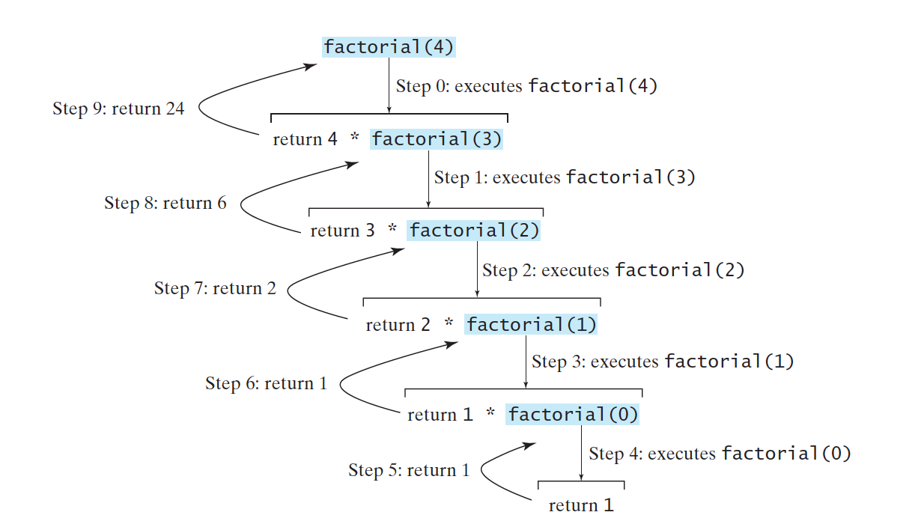
Recursive factorial

Slide 5
Recursion
All recursive methods have:
  Conditional statements such as if-else to select different cases
  One or more base cases (the simplest case) to stop the recursion
  Recursive call to ‘reduce’ the original problem to closer to the base cases

Slide 6
Recursive thinking
To solve a problem using recursion, the key is to identify the sub-problem
Sub-problem: same as original problem but smaller in size
Ask yourself: what is the “size” in your problem?
Recursive step: how to use the sub-problem to solve your original problem?

Slide 7
Recursive Fibonacci
fib(0) = 0
fib(1) = 1
fib(n) = fib(n-1) + fib(n-2)
public static int fib(int n)

Slide 8
Palindrome
Write a recursive method for finding palindrome: a word that reads the same backwards as forwards
Example outputs:
  abba is a palindrome.
  abdcba is not a palindrome.
public static boolean isPalindrome (char [] s)

Slide 9
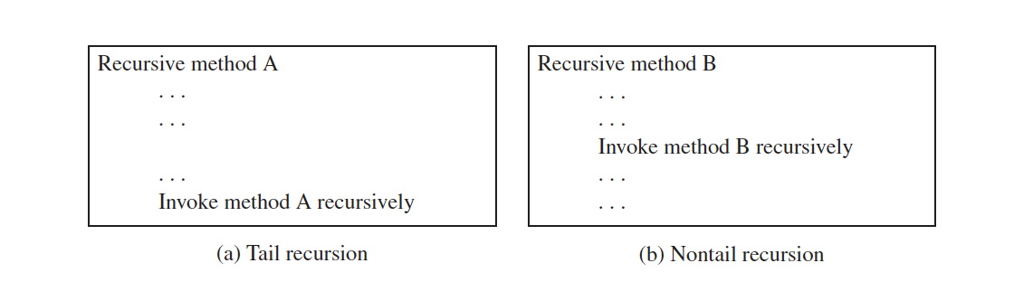
Tail recursion
Tail recursive method: no pending operation after the recursive call
Method ends with the last recursive call; there is no need to store the immediate calls and this can reduce resource

Slide 10
Binary Search
Find the position of a target value within a sorted array
Compare the target value to the middle element of the array
If they are not equal, the half in which the target cannot lie is eliminated and the search continues on the remaining half
public static int binSearch(int [] a, int target, int l, int r)

Slide 11
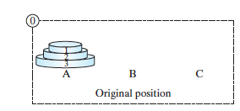
Towers of Hanoi
Moving a specified number of disks of distinct sizes from one tower to another
Move one disk at a time, smallest one on a tower
No disk can be on top of a smaller one
How to move: A -> B?

Slide 12
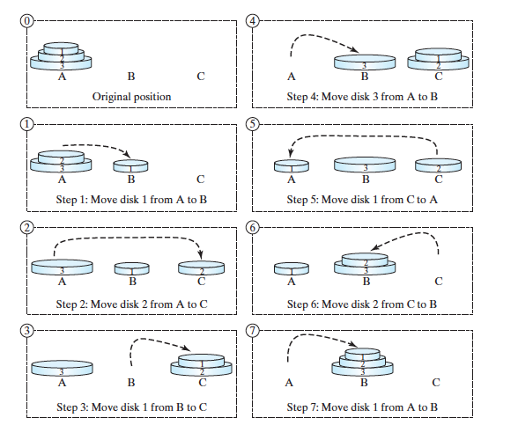
Towers of Hanoi
3 disks

Slide 13
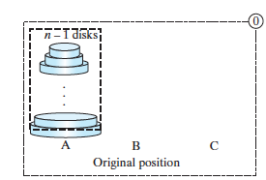
Towers of Hanoi
n disks:

Slide 14
Recursive Fibonacci
fib(0) = 0
fib(1) = 1
fib(n) = fib(n-1) + fib(n-2)
public static int fib(int n) {
if (n==0)
return 0;
else if (n==1)
return 1;
else
return fib(n-1) + fib(n-2);
}

Slide 15
Binary Search
public static int binSearch(int [] a, int target, int l, int r){
if (l>=r) {
if (a[l] == target)
return l;
else return -1;
}
else {
int mid = (l+r)/2;
if (a[mid] == target)
return mid;
else {
if (target < a[mid]) return binSearch(a, target, l, mid-1);
else return binSearch(a, target, mid+1, r);
}
}
}

Slide 16
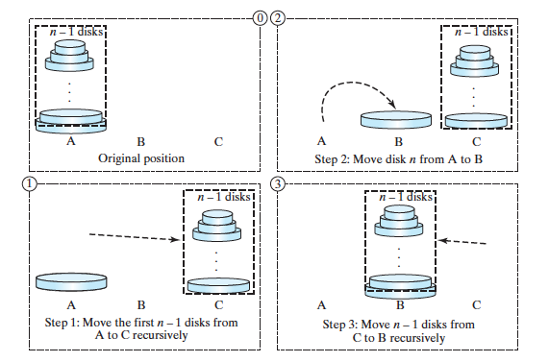
Towers of Hanoi
n disks:

